Slide 1


Learn & Grow
Team - 3 Virtual Presentation
Date: July 14, 2025
Time: 11:30 PM - 11:45 PM EST
© Per Scholas 2025 | Team-3
Notes:
Facilitator Notes (Conversational):
"Good [morning/afternoon/evening], everyone — and welcome to the CGI + Per Scholas HackJam!

Slide 2

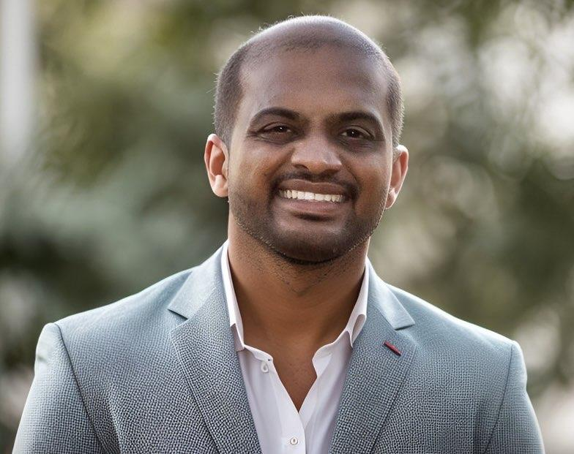
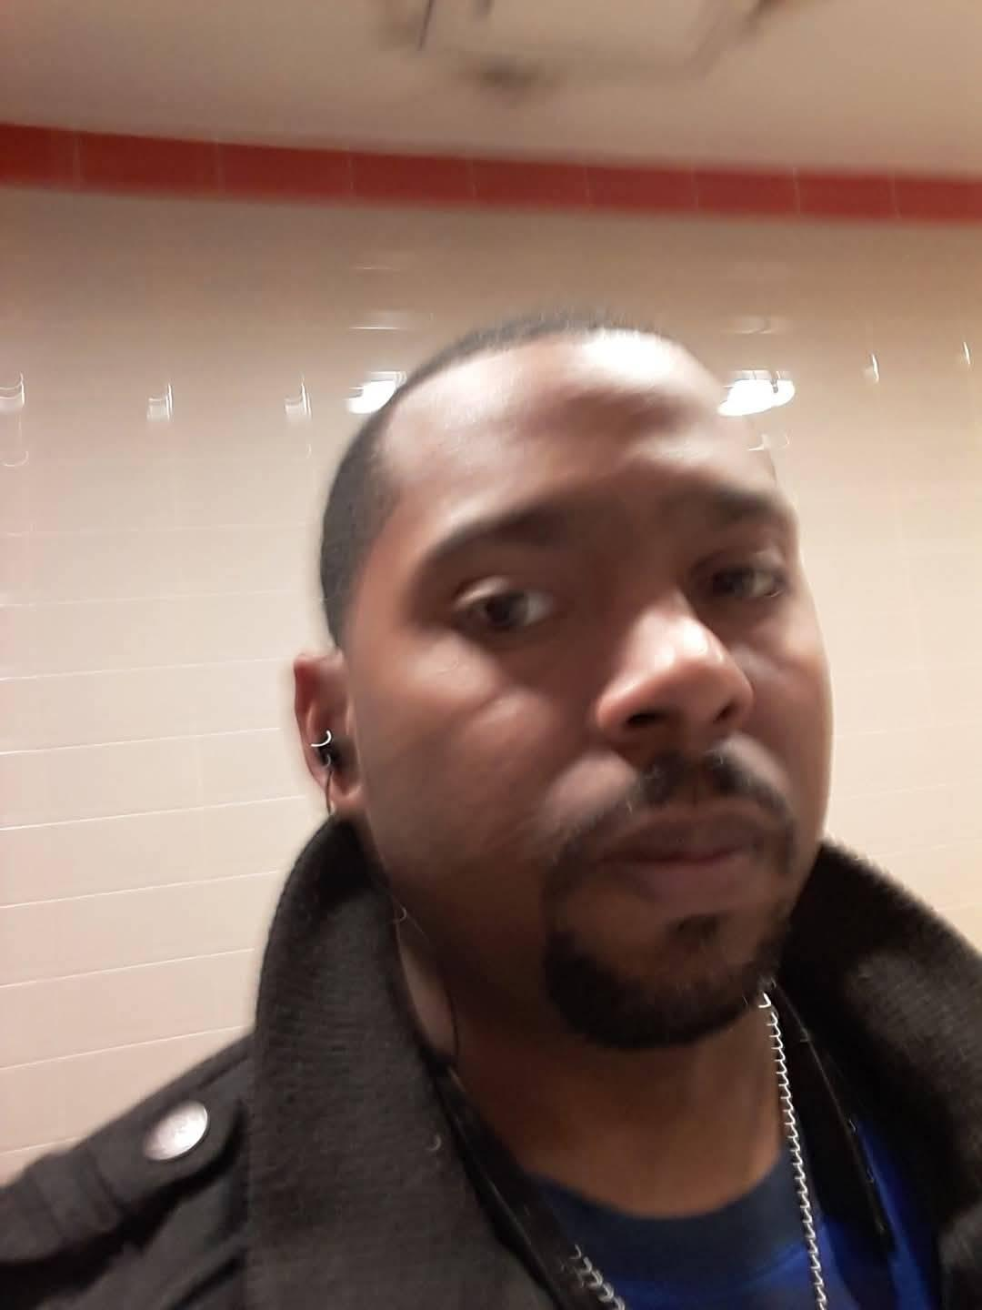
Meet Our Team Members
Padmaja Ramesh Back-end Developer
Dinesh
Mentor
Melvin Kemp
Front-end Developer
© Per Scholas 2025 | Team-3
Notes:
Facilitator Notes (Conversational):
"Before we get started, I want to briefly recognize the unique partnership that makes this experience possible.
Before we dive in, let’s recognize who’s behind today’s session.
CGI is one of the world’s leading technology consulting companies, working with clients across government, healthcare, finance, cybersecurity, cloud, and more.
Per Scholas is one of the top national workforce development organizations, helping individuals build technology careers and bridging the opportunity gap for underrepresented talent.
Now let’s meet your alumni Committee! Tina Hubbert your Alumni Committee President, will greet you all at this time.

Slide 3

Business Case
Problem Statement
Alumni engagement post-graduation is inconsistent.
Limited tracking and incentivization for continued learning, mentorship, or community contribution
Solution Overview
A gamified alumni platform to track achievements and incentivize continued engagement.
© Per Scholas 2025 | Team-3
Notes:
Read the Slide.

Slide 4
courses
id
title, description, category, difficulty, estimatedDuration
instructor, instructorId
learningObjectives (array)
lessons (array of embedded objects: id, title, content, estimatedTime, order)
tags (array)
enrolledCount (number)
isPublished (bool)
createdAt
lesson_notes
id
userId (ref: users)
courseId (ref: courses)
lessonId (from courses.lessons)
notes (string)
createdAt, updatedAt
enrollments
id
userId (ref: users)
courseId (ref: courses)
enrolledAt, lastAccessedAt
progress (number)
completedLessons (array of lesson ids)
currentLesson (lesson id)
users
id (Firestore UID)
firstName, lastName, email, location, role
createdAt
achievements (array)
points (number)
badges (array)
posts
id
title, category, content
authorId (ref: users)
authorName
createdAt
replies (array of objects: content, authorId, authorName, createdAt)
events
id
title, eventType, description, eventDate, eventTime, location, isOnline, capacity
organizer, organizerId
attendees (array of userId)
createdAt
lesson_views
id
userId (ref: users)
courseId (ref: courses)
lessonId (from courses.lessons)
timestamp
© Per Scholas 2025 | Team-3

Slide 5
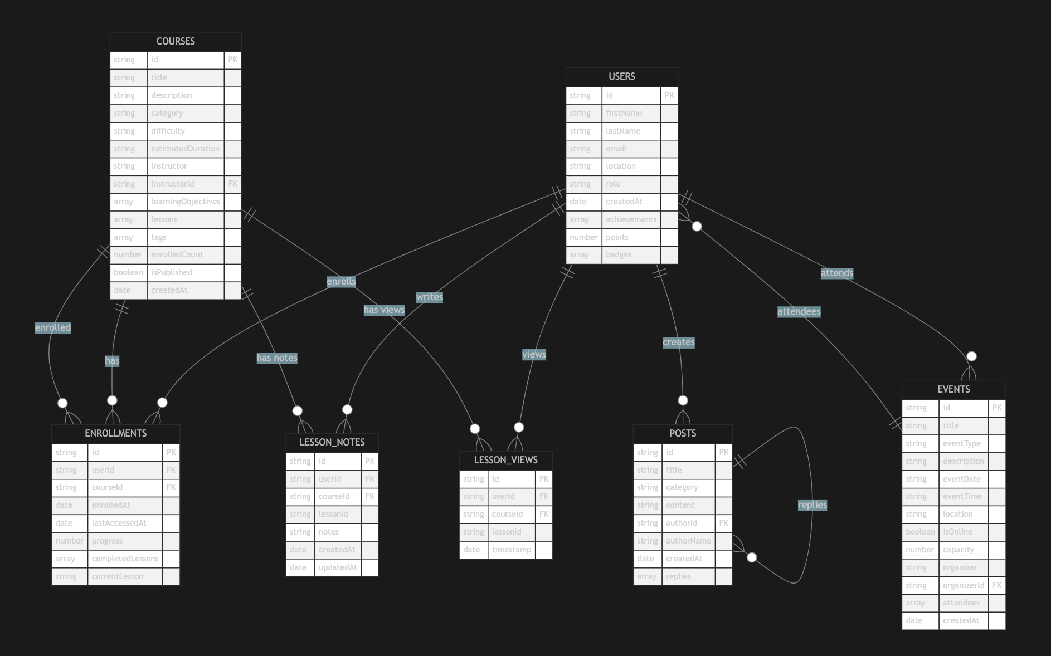
ER Diagram
© Per Scholas 2025 | Team - 3
Notes:
Facilitator Notes:
"Tonight is all about strengthening your Human Firewall. That means building the skills to navigate people, communication, and especially conflict. Conflict isn’t necessarily a negative thing — it's a barrier. And like any barrier, it has to be addressed if you want buy-in, alignment, and real results. Employers value people who can lean into tough moments, resolve misunderstandings, and lead with clarity and connection.."

Slide 6
Due to Time Constraints
[ Frontend UI ]
HTML/CSS/JS (Firebase Hosting)
│
▼
┌───────────
│ Firebase Firestore │
│ ├ Auth (Login/Signup) │← Demo
│ └ Cloud Functions │
└───────────
Planned Production Stack
┌────────────
│ Node.js API (Express) │
│ ├ JWT Auth │
│ └ Business Logic │
│ │
│ MongoDB Atlas │
│ └ Long-term Storage │
│ │
│ API Doc │
│└ Swagger-doc │
└────────────
© Per Scholas 2025 | Team-3
Notes:
Read Slide.

Slide 7
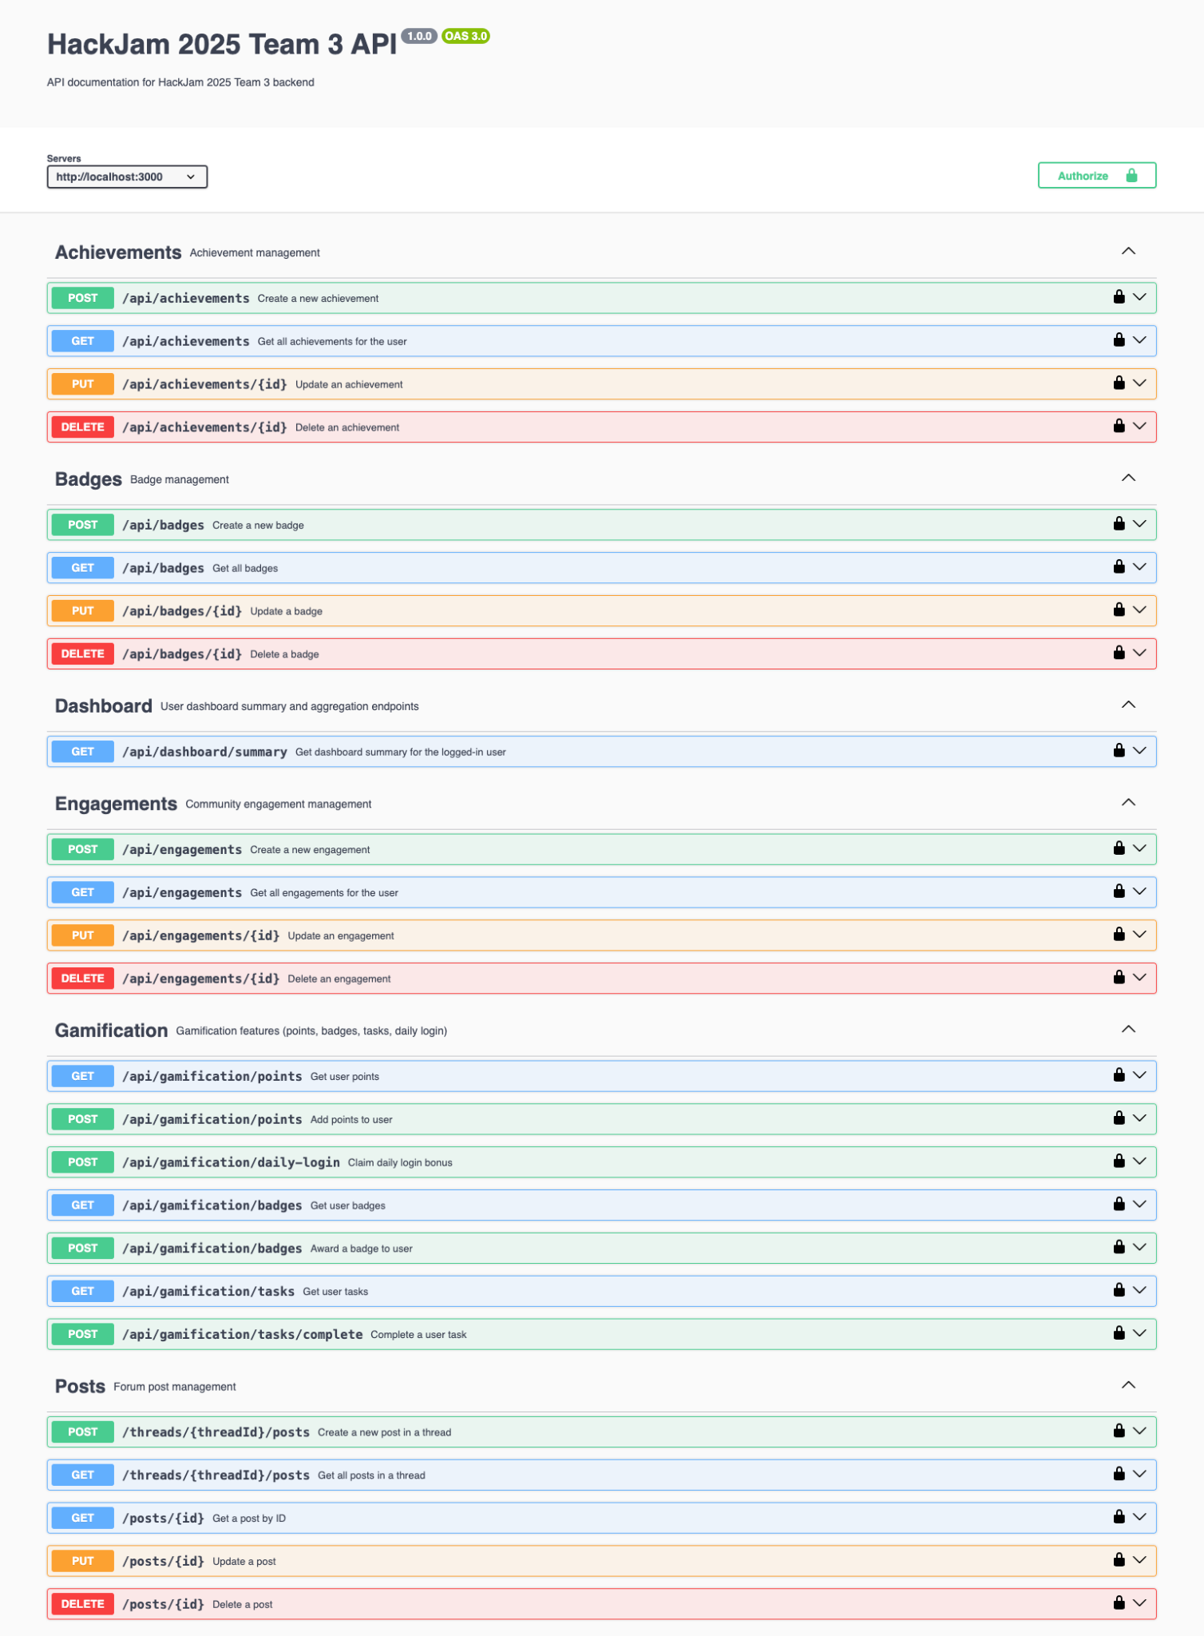
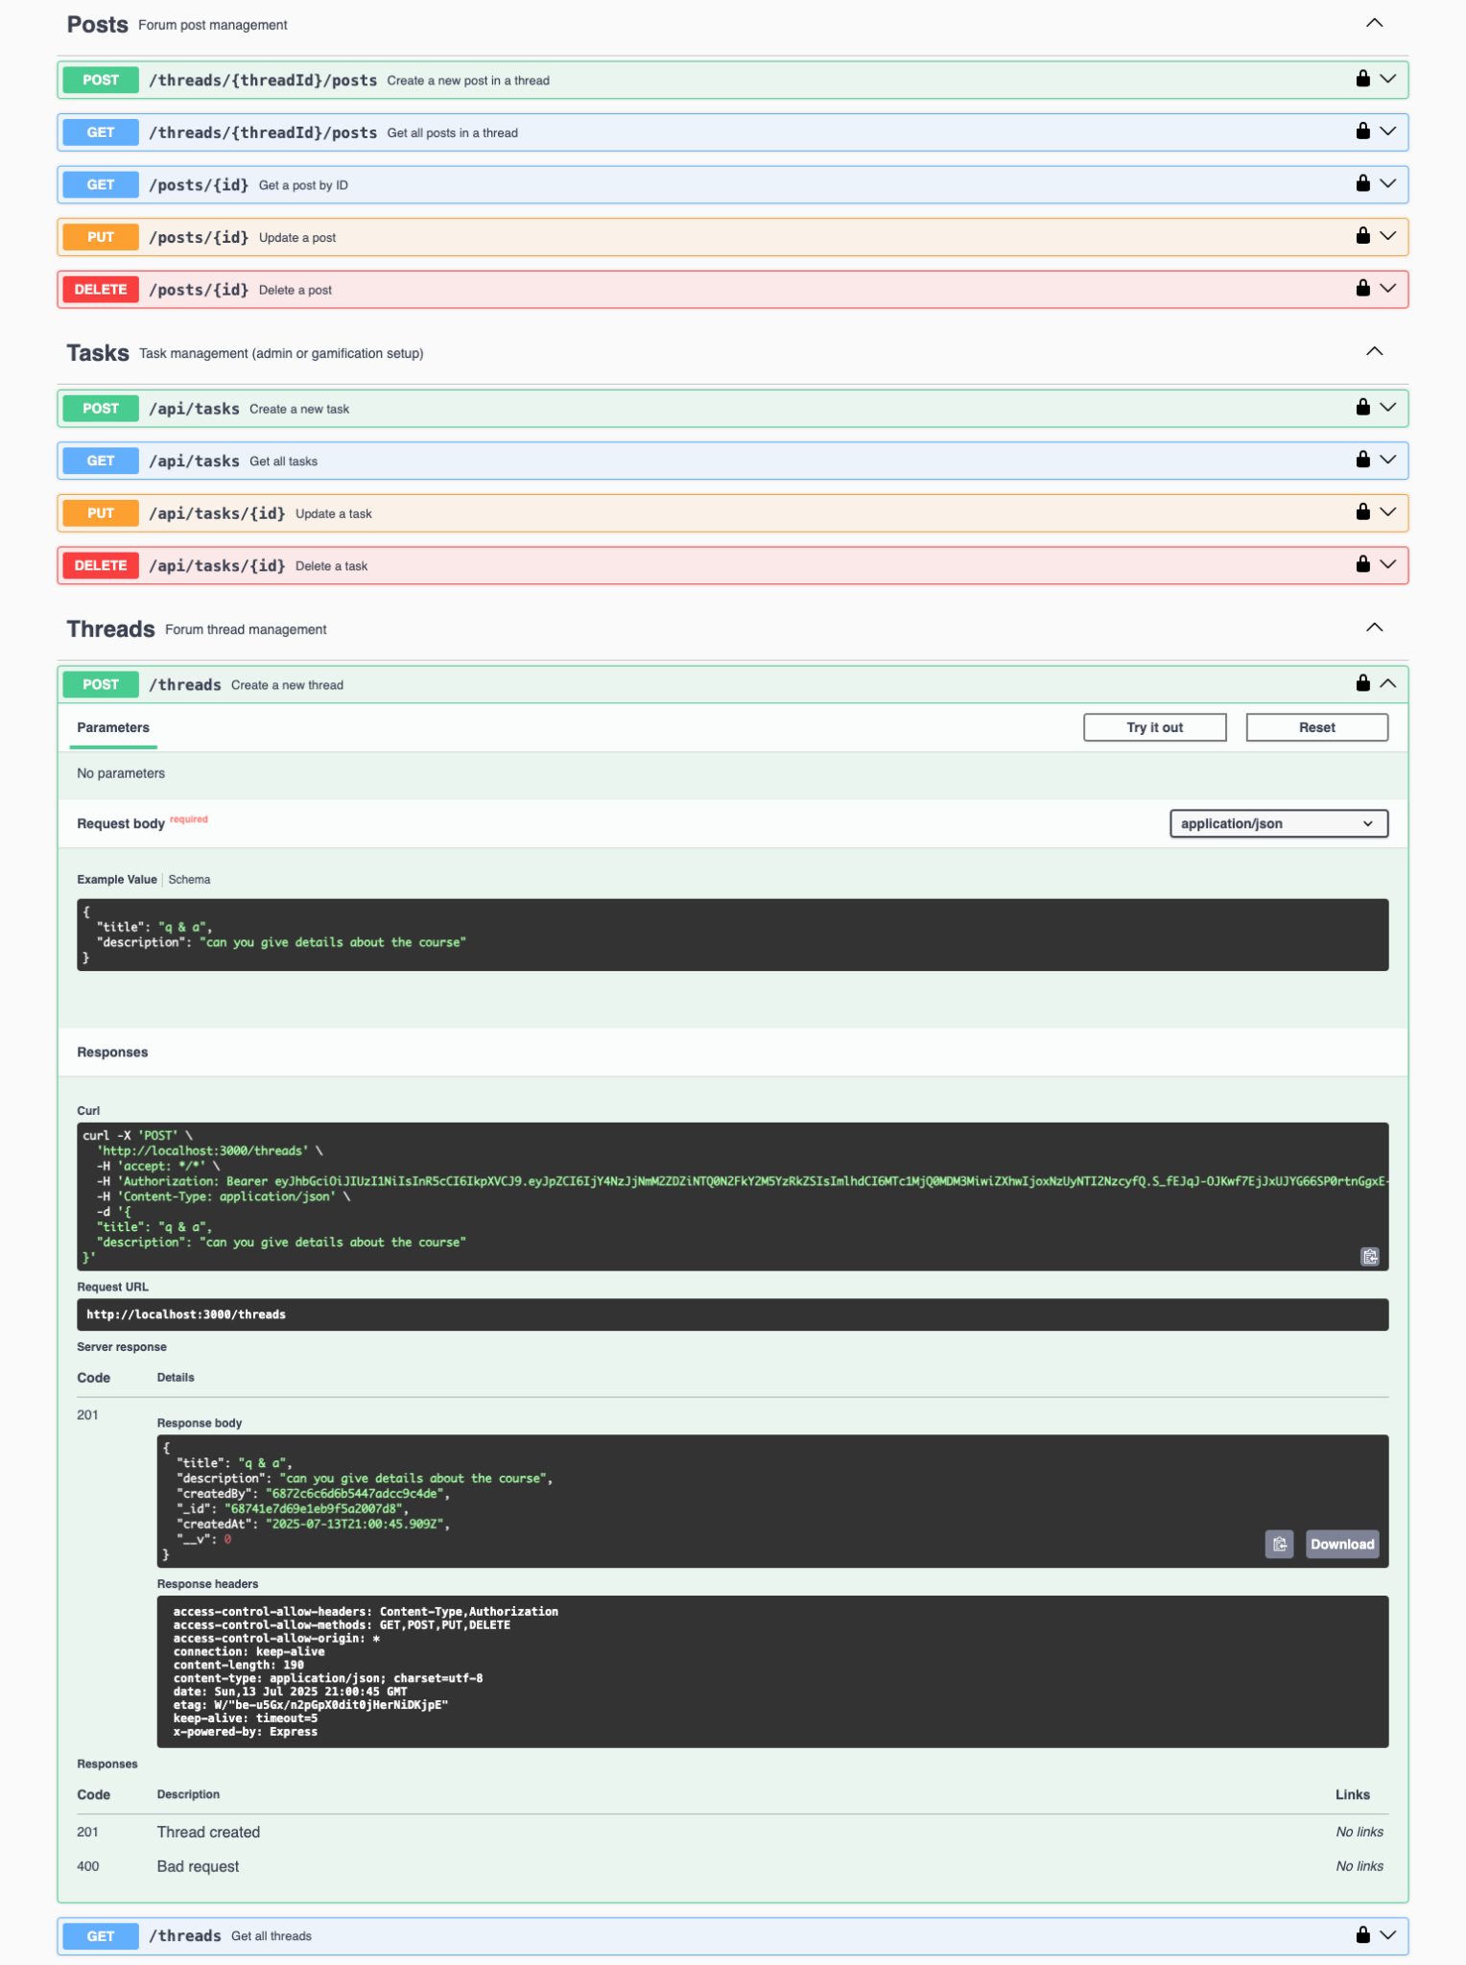
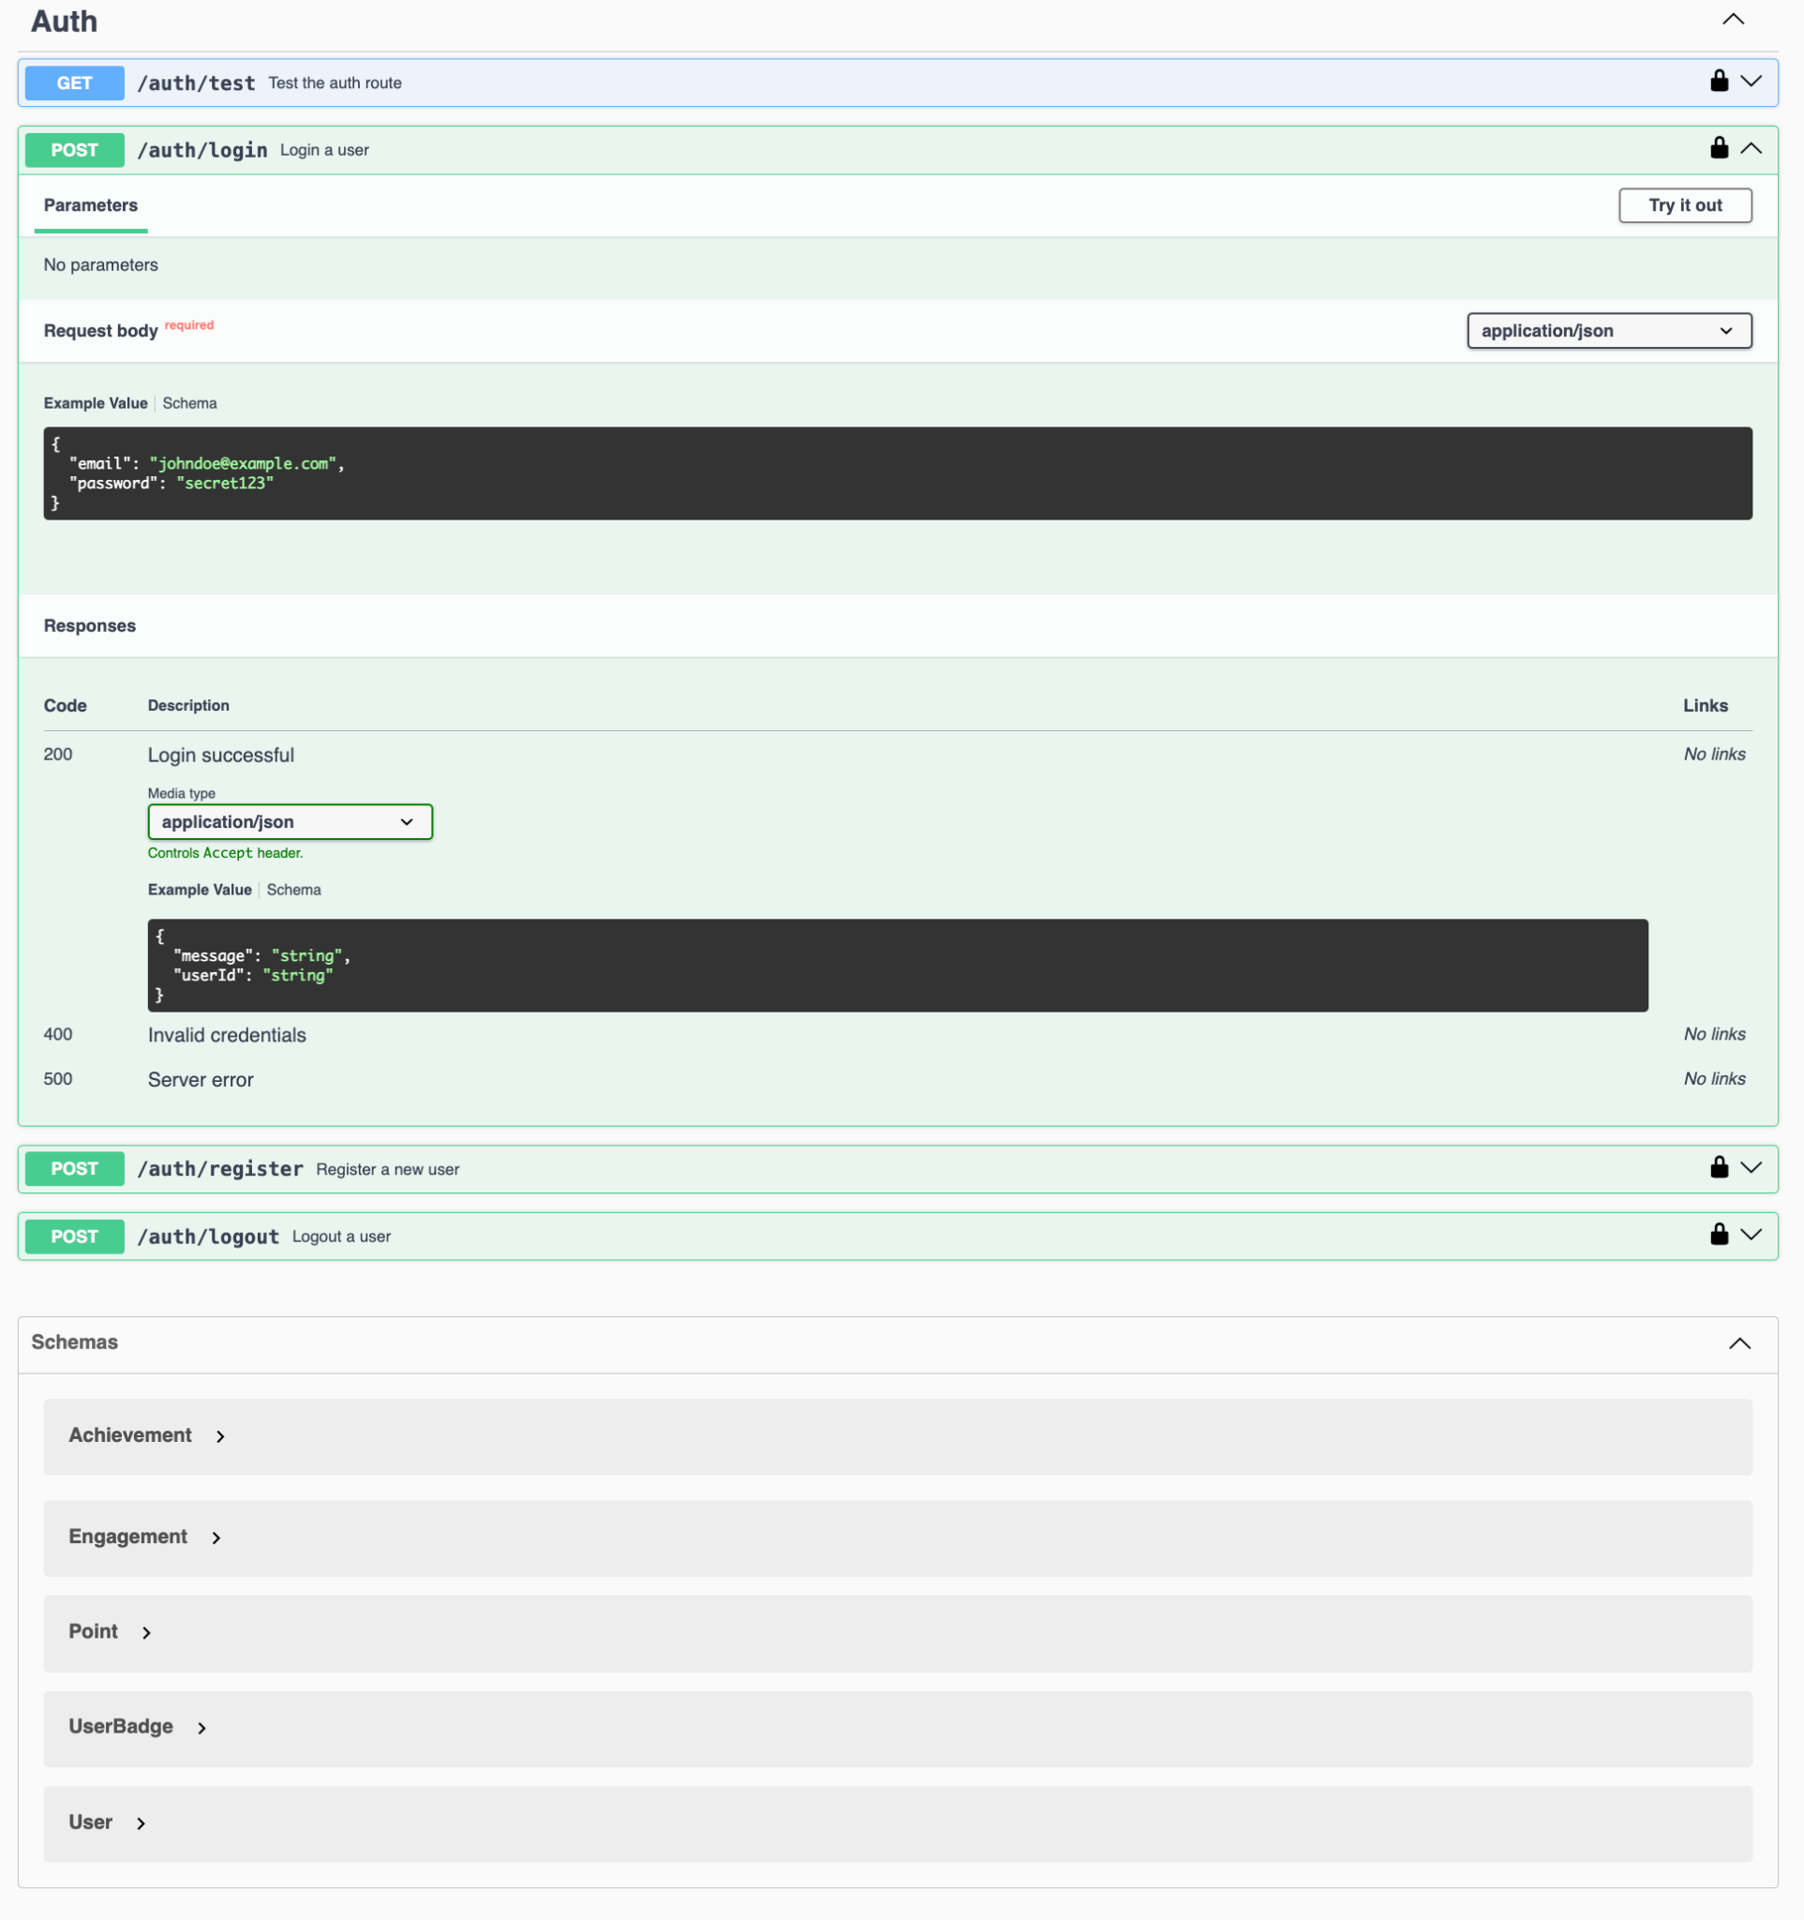
API DOCS
© Per Scholas 2025 | Team-3
Notes:
Facilitator Notes (Revised): Your technical skills may get you noticed — they land the interview and open doors. But it’s your human skills that determine what happens next: whether you're trusted on a team, asked to lead, promoted, or even retained.
🧠 In fact, 89% of hiring failures happen due to soft skill issues. ⚖️ 91% of employers say these skills matter as much or more than technical ones. 📉 And only 14% of managers say their teams actually excel at them.
In every engineering environment — whether it’s your first job or a judged competition — how you communicate, collaborate, and handle pressure is what sets you apart.
📢 In January 2025, communication topped nearly 2 million job postings. 🧩 And in April 2024, 84% of managers said new hires must actively demonstrate soft skills.
This is where projects move forward — or stall. It’s also where careers start to grow — or quietly stall out.

Slide 8
Live DEMO
url / Link : Learn & Grow
github link : Team -3
© Per Scholas 2025 | Team - 3
Notes:
Facilitator Notes (Conversational):
"Alright y’all — let’s quickly go over how you can earn your official CGI + Per Scholas HackJam Certificate of Completion.
This certificate is more than just a keepsake — it’s a signal that you showed up, stayed engaged, and practiced the kind of professional skills that make teams — and careers — thrive.
Here’s what you need to do:
✅ First, fully participate in today’s session. That means jumping into the chat, showing up in the breakout rooms, and being part of the conversation. We’re not expecting perfection — just authentic engagement.
✅ Second, you’ll complete a 21-question multiple choice Knowledge Check at the end. Everything you need to answer those questions will be covered today, so no pressure — just pay attention and participate.
✅ Third, aim to get a score of 80% or higher on that check. That shows you’ve absorbed the key skills we’ve been focusing on — communication, collaboration, and conflict resolution.
✅ And lastly, you’ll need to complete the Post-Session Survey. It helps us make these sessions better and also lets us know who met all the participation benchmarks.
📩 After the event, certificates will be emailed directly to you by the CGI Alumni Committee, once we confirm you’ve completed all the steps.
We’ll give you time at the end to knock out the survey and Knowledge Check, and I’ll stick around in the chat in case any questions come up. Sound good?"

Slide 9
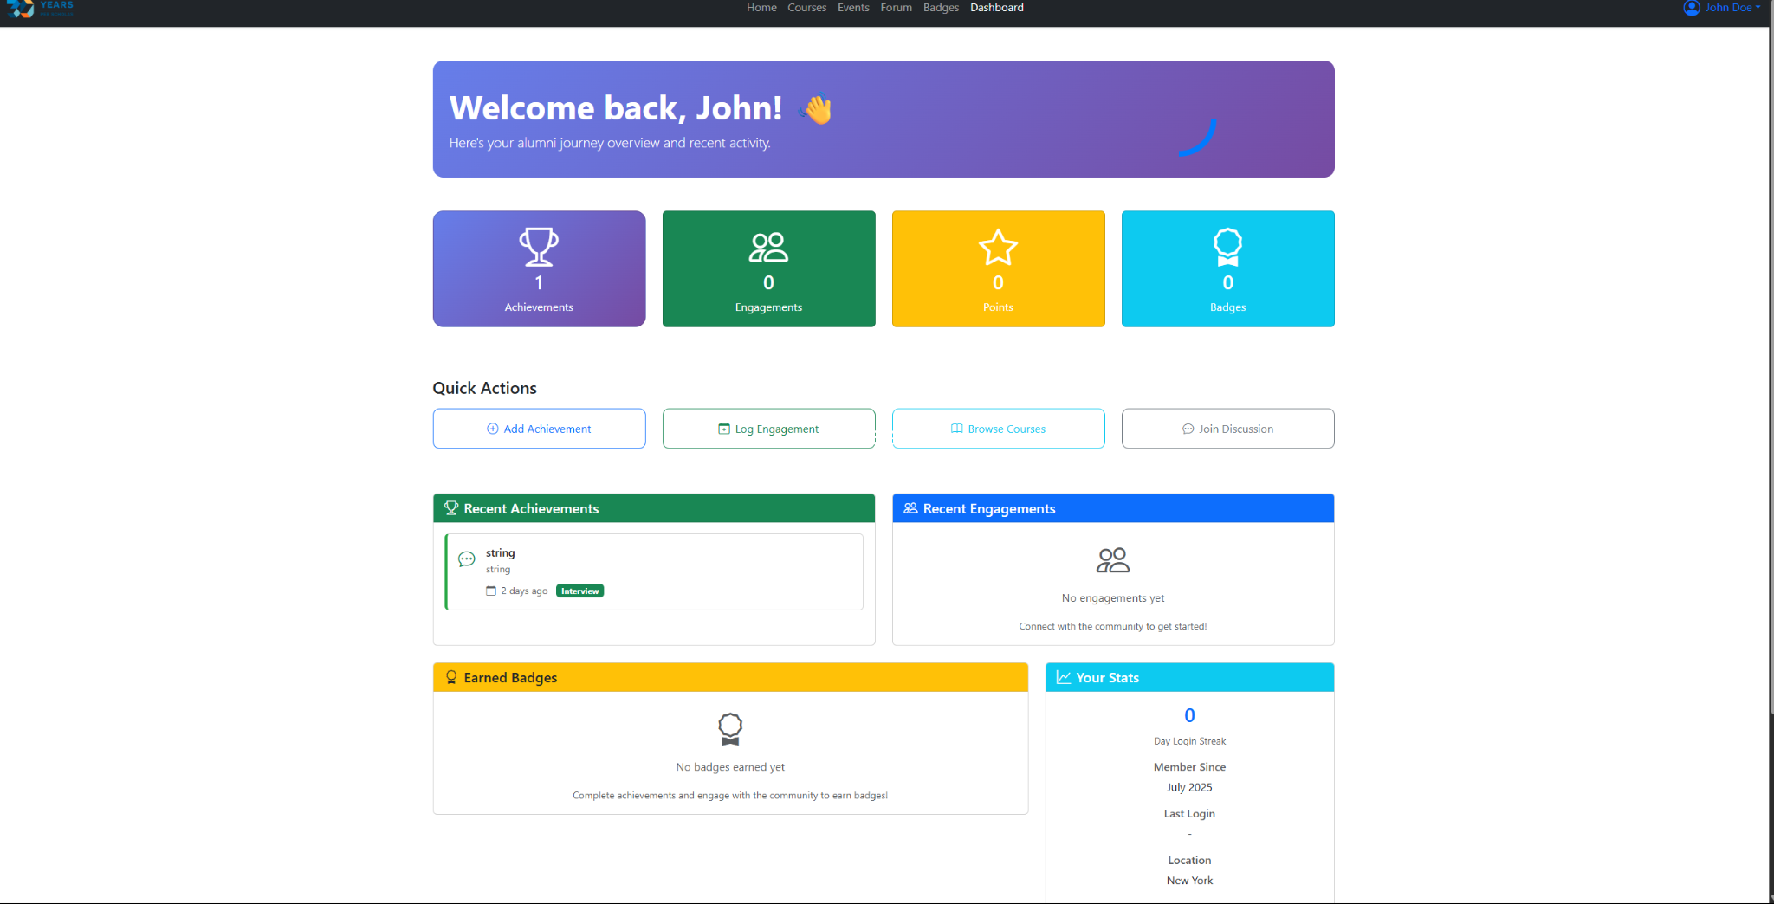
Learn & Grow Dashboard
© Per Scholas 2025 | Team - 3
Notes:
Facilitator Notes (Conversational):
"Alright y’all — let’s quickly go over how you can earn your official CGI + Per Scholas HackJam Certificate of Completion.
This certificate is more than just a keepsake — it’s a signal that you showed up, stayed engaged, and practiced the kind of professional skills that make teams — and careers — thrive.
Here’s what you need to do:
✅ First, fully participate in today’s session. That means jumping into the chat, showing up in the breakout rooms, and being part of the conversation. We’re not expecting perfection — just authentic engagement.
✅ Second, you’ll complete a 21-question multiple choice Knowledge Check at the end. Everything you need to answer those questions will be covered today, so no pressure — just pay attention and participate.
✅ Third, aim to get a score of 80% or higher on that check. That shows you’ve absorbed the key skills we’ve been focusing on — communication, collaboration, and conflict resolution.
✅ And lastly, you’ll need to complete the Post-Session Survey. It helps us make these sessions better and also lets us know who met all the participation benchmarks.
📩 After the event, certificates will be emailed directly to you by the CGI Alumni Committee, once we confirm you’ve completed all the steps.
We’ll give you time at the end to knock out the survey and Knowledge Check, and I’ll stick around in the chat in case any questions come up. Sound good?"

Slide 10
THANK YOU FOR THE OPPORTUNITY
© Per Scholas 2025 | Confidential & Proprietary
Notes:
Read Slide.

